Slide 1
How to Architect Big Data Apps with the Lambda Architecture
OCTOBER 2014
Altan Khendup – Big Data Architect
Ron Bodkin – Founder Think Big, a Teradata company

Slide 2
Real-Time
Low latency
Query response
Data refresh
End-to-end response
… nanoseconds, milliseconds, seconds, or minutes depending on your problem
Two basic patterns
Strategic insight: decision support
Process execution: system of engagement/operational analytics
Copyright 2013-2014 Think Big, a Teradata Company
Notes:
Storm – 100’s of milliseconds to 5 seconds

Slide 3
Real-time Demand Growing
Many users looking to gain valuable insights from both batch and real-time systems
User Characteristics
Do not always understand the complexities of tackling this challenge
Also want to use familiar/easy-to-use interfaces wherever possible
Want best practices about ways to integrate real-time (current) and batch (historical)
Often not aware of all the options and trade-offs among them

Slide 4
Enter Lambda Architecture
Lambda Architecture…
Provides a common architectural pattern for discussion
Provides a more clear picture of the complexities typically found in most organizations
Some challenges in tackling Lambda architecture
Complete Lambda requires more than just a single system
Typically requires multiple components
E.g. Batch/cold storage via e.g. Hadoop, Real-time/current data via e.g. Storm, Query via e.g. business analysis using a database
Also some challenges in delivering results to the business
Coordination is very difficult across the stack
Quality results back to the organization very important
Takes a lot of knowledge/expertise/technology to tackle
Not typically a first step in Big Data implementation

Slide 5
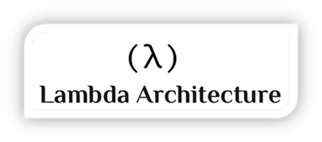
Background of Lambda Architecture
Background
Reference architecture for Big Data systems
Designed by Nathan Marz (Twitter)
Defined as a system that runs arbitrary functions on arbitrary data
“query = function(all data)”
Design Principles
Human fault-tolerant, Immutability, Computable
Lambda Layers
Batch - Contains the immutable, constantly growing master dataset.
Speed - Deals only with new data and compensates for the high latency updates of the serving layer.
Serving - Loads and exposes the combined view of data so that they can be queried.
Notes:
Lambda = architectural pattern to talk about the complexity of dealing with real-time and historical datasets
Overall use
Prescriptive/Predictive uses rely on some dimension of real-time
Use cases
CPG – consumer goods looking at what customers are doing in real-time and making adjustments
Medical – real-time medical sensors and treatment and labs for critical patient care
Financial – credit risk and transaction fraud
Manufacturers – IoT/Telematics getting information from their plants and logistics, cross referencing to inventory, and making adjustments to supply chain

Slide 6
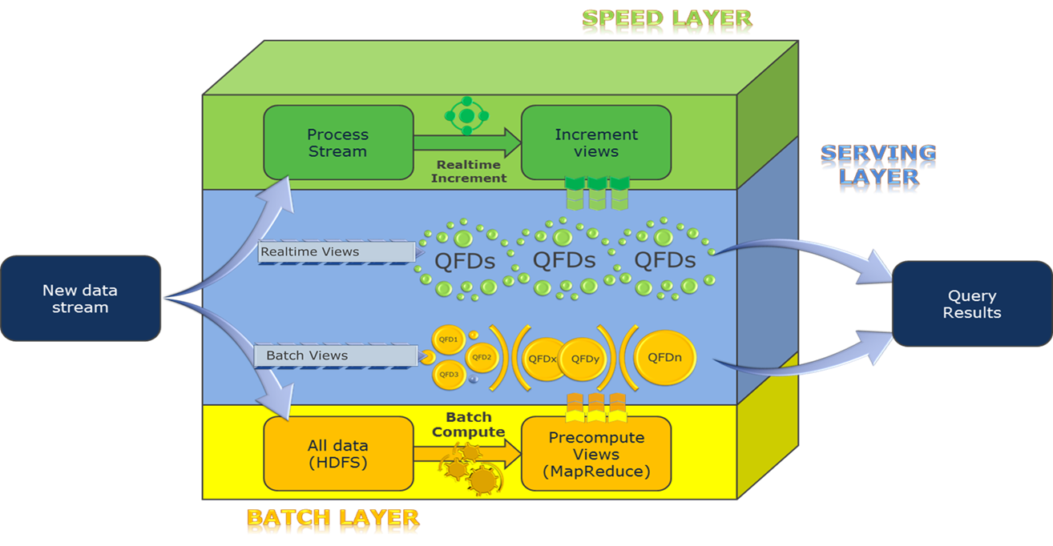
Overview of Lambda Architecture
Notes:
General architecture that covers how Lambda works overall
Able to address real-time and historical data
Layers
Speed – real-time/current data streams; spark, storm, etc.
Batch – historical data layer
Serving – ability to take the current data and historical and merge the results and provide that to the organization
Real-world experience/strategy
Do not tackle all of the data but rather necessary segments of business functionality called queries
Data can be tackled per query hence the idea of “query focused datasets” or qfds
Allows for more focused results/faster speed gains

Slide 7
USE CASE - MEDICAL

Slide 8
Every year, more than a million people from all 50 states and nearly 150 countries come for care
Challenges in Medical Data
Health data tends to be “wide”, not “deep”
New data types are becoming more important
Unstructured
Real-time streaming
A challenge to generally move from retrospective “BI” viewing to event-based and predictive analytics usage

Slide 9
Optimize an existing Natural Language Processing pipeline in support of critical Colorectal Surgery
(Move to tens of thousands of documents processed)
Replace an existing free-text search facility used by Clinical Web Service for colorectal cancer
(Move search to milliseconds)

Slide 10
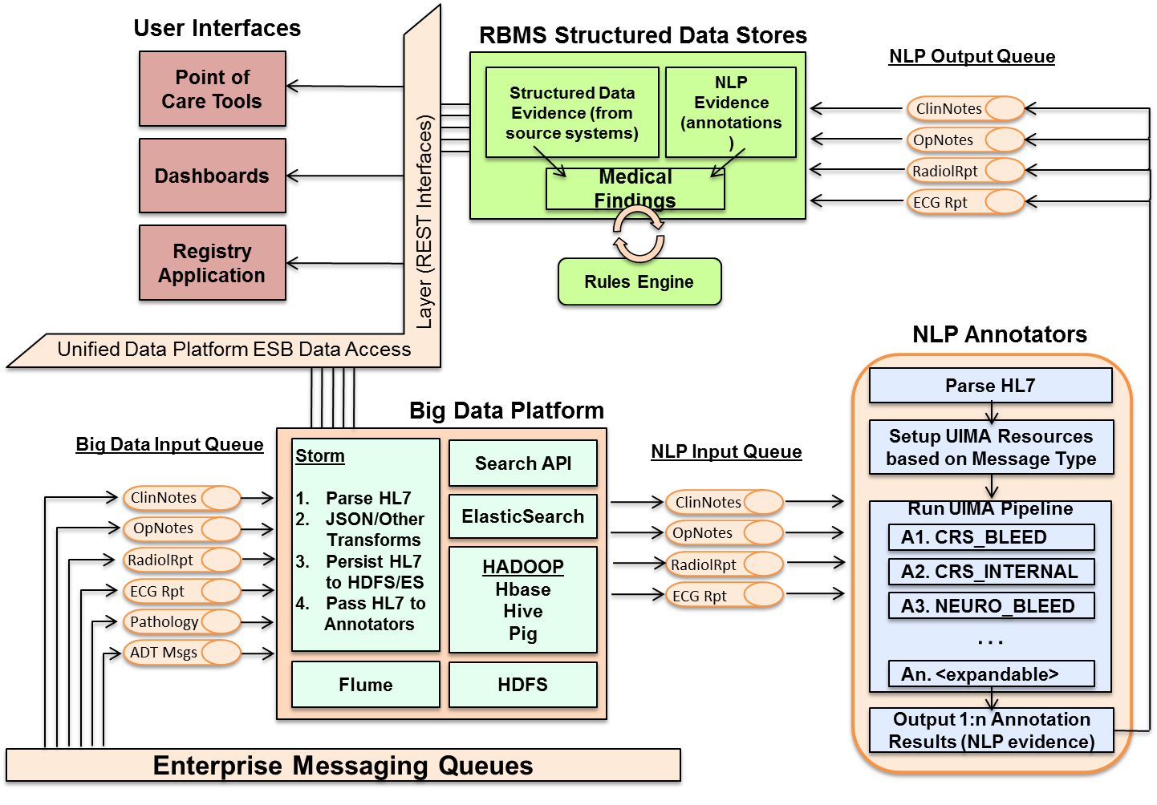
Overall Architecture

Slide 11
Operational Statistics
Current Storm throughput up to 1.5 million documents per hour
Average of 140,000 HL7 messages actually processed per day with average latency of 60 milliseconds from ingest to persistence
Average of 50,000 documents passed through annotators per day versus 5,000 historically
Actual annotations of documents up to 6 times faster than previously accomplished
Free-text search use cases that took over 30 minutes on old infrastructure completing in milliseconds in ElasticSearch
Notes:
HL7 actual processing based on “pull” requests from users not actual processing power
HL7 are large xml-based documents
Much larger than say JSON or others (roughly 800k-900k in size)
Contains significant data related to medical information
End goal
An architecturally-driven, internally-owned technology stack that blends:
An event-based processing fabric
A real-time processing framework
A multi-destination distillation hub
“Classic” BI delivery techniques
“Services-based” delivery techniques
A “serendipitous” discovery environment
Mutually supportive components that combine in delivering novel clinical solutions.

Slide 12
Implementing Lambda
Challenges
Multiple layers
Lots of events, data
Complex
Lots of different languages and data structures
Difficult to maintain
Lots of moving pieces/components/technologies
Lots of changes for the business
Need for Practical Lambda approach
Based on real-world implementations
Metadata model (events and data)
Discrete data (query focused datasets)
Data convergence (holistic query focused dataset)

Slide 13
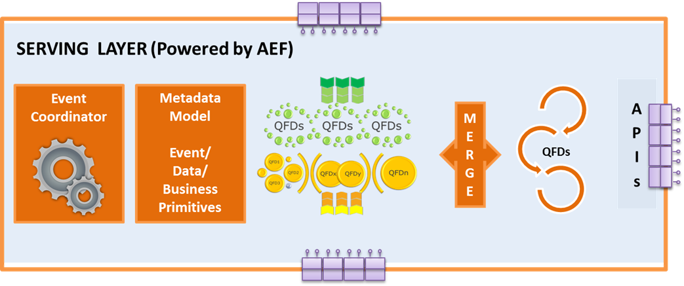
Active Executor Lambda Framework
Notes:
The serving layer coordinates bringing this data together and creating a holistic view of the data
Teradata understands some form of event and corresponding coordination of events to bring the data across the layers to the serving layer
A general metadata model for data lineage and transformations
Merge the data together into a holistic data set so that it can be served to consumers
A context component that allows events, data, and requests to be held together
Rules engine that allows for determinations based on sensing patterns
Workflow/Dataflow for execution of necessary processing on data
Save on the constant re-computation
Snapshotted/versioned data
Calculations done on these versions
Can be worked with varios data structures and Hadoop components
Full re-computation can be deferred and used to verify/replace specific snapshots

Slide 14
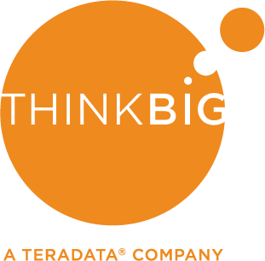
Real Time and Lambda

Slide 15
KISS
Real-Time isn’t free!
1 hour vs. 5 min vs. seconds
And may not be meaningful anyhow
Is there a robot or a human in the loop?
Simpler Instantiations of Lambda
Micro-Batch Feeds & Real-Time Queries
Embarrassingly Parallel Speed Layer
Transient Speed Layer
… One database for Speed & Serving (RDBMS or NoSQL)

Slide 16
Use Case: Cross-Channel Behavior Analytics
Understanding consumer purchase behavior across more than one touch point to drive holistic results
Each channel for consumer marketing and engagement has siloed applications and analytic tools
Correlating behavior across channels to understand customer journeys allows better engagement (e.g., web, mobile, call center, in store, email, social)
Common goals: increased response rates, increased share of wallet, reduced churn, focus on high value customers, increase customer satisfaction
Challenges: data volumes, correlation/sessionization, feature discovery

Slide 17
Real-Time Queries Pattern
Queue
Micro-
batch
Query/Serving
Events
Web server…
HBase/
Teradata/Hive…
Kafka etc
Hadoop
Many analytics use cases can be handled with update latencies of a few minutes
Micro-batching allows for dramatic efficiency improvements
… can extend to updates per event with additional infrastructure
Pre-aggregation (HBase, MPP, etc.) can serve many users
Hadoop query (Hive 0.13+ / Tez, Impala etc.) emerging

Slide 18
Use Case: Recommendations
Recommendations rely on
recent activity (purchases, content viewed, product interest, support issues)
trends/fashion
long-term propensity (relationship history, micro-segments, social…)
The opportunity is to integrate deep insight into
Behavior
Social graph
Building product recommendations/person/next best offer that’s maximally effective
All A/B tested

Slide 19
Embarrassingly Parallel Speed Layer Pattern
Queue
Micro-
batch
Hadoop
Events
Kafka etc
NoSQL/Speed
Web server…
HBase/
Mongo…
Many operational use cases can be distributed across app server farm
Batch computed views pushed to NoSQL
Read NoSQL, update, respond & write to NoSQL can be done quickly
No need for streaming analytics/computation

Slide 20
Conclusions
There are many kinds of real-time problems
No one Big Data technology solves all the problems
Lambda architecture provides a powerful way to solve the more sophisticated
There are simpler approaches for simpler problems…
…which may be a step towards Lambda
Copyright 2013-2014 Think Big, a Teradata Company

Slide 21
We’re Hiring!
thinkbig.teradata.com
Booth #324

Slide 22


Thank you!
Altan Khendup (@madmongol)
Ron Bodkin (@ronbodkin)

